Slide 1
CentiSoft Time Registration

Slide 2

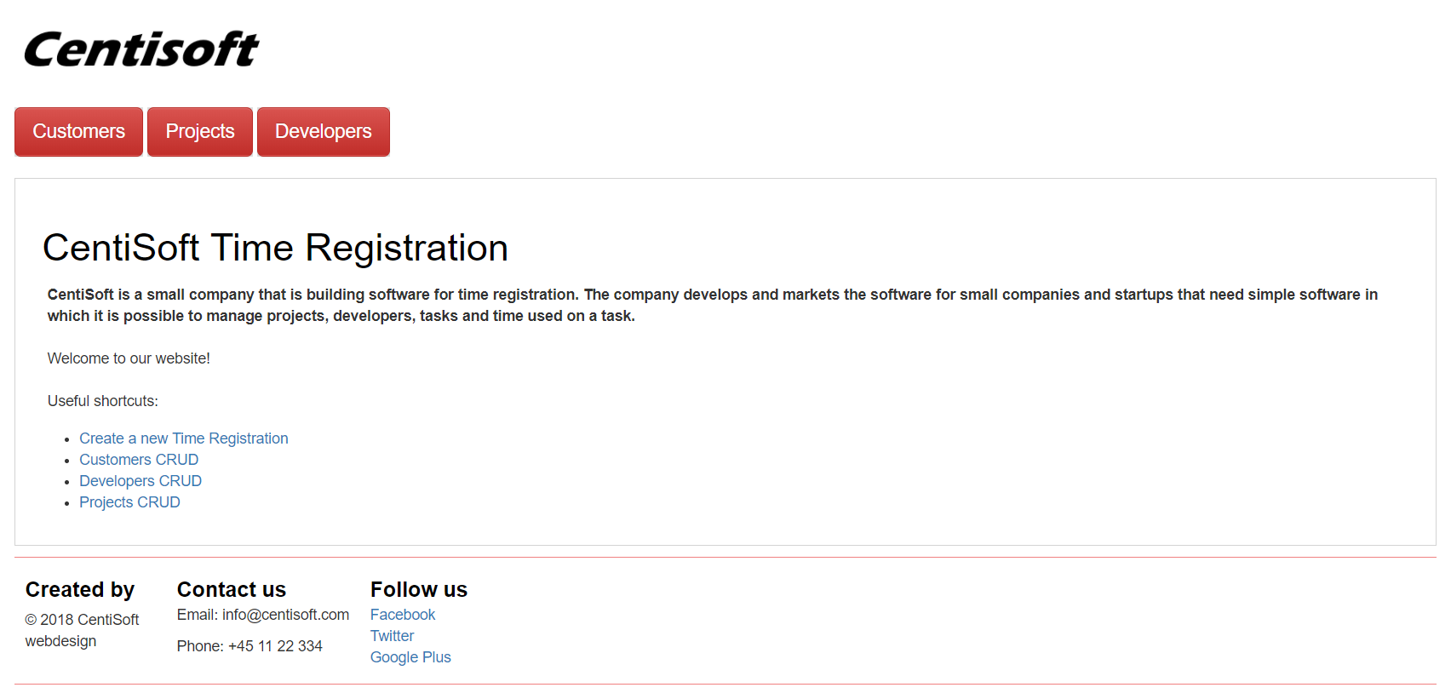
index.html

Slide 3
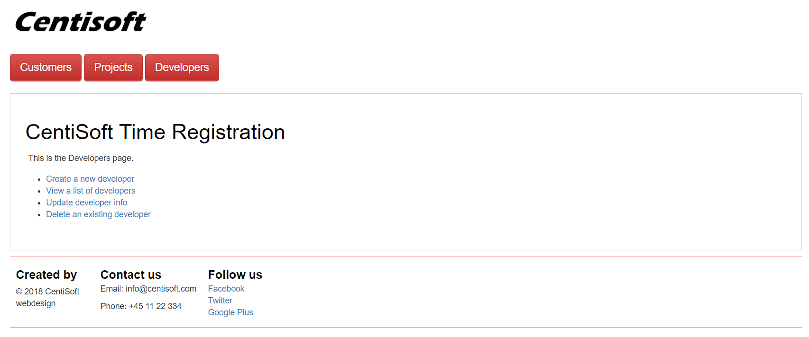
developers.html

Slide 4
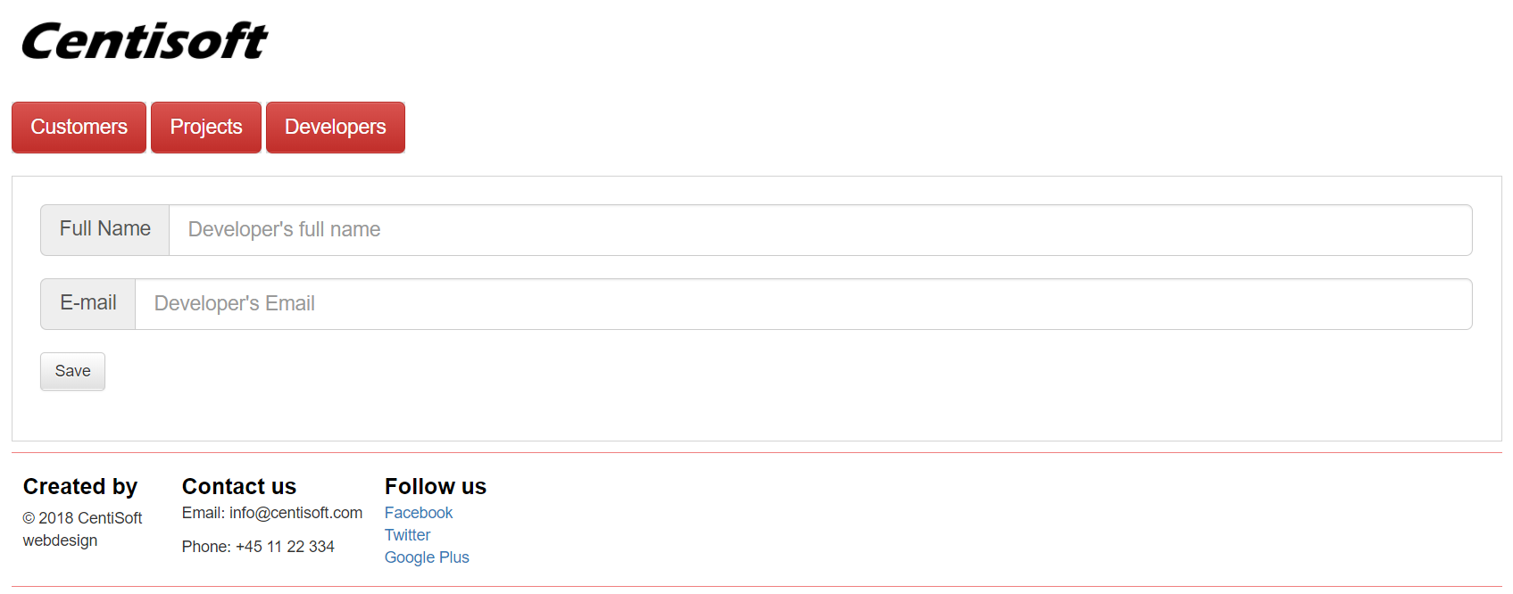
createDevelopers.html

Slide 5
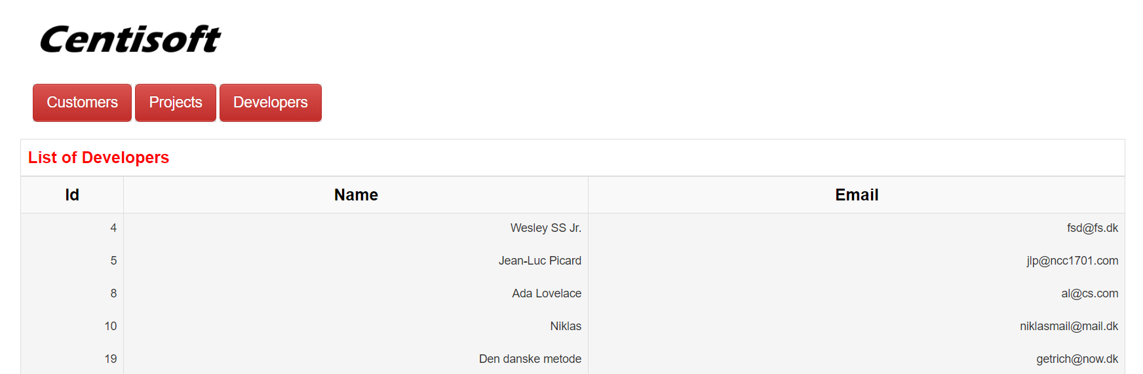
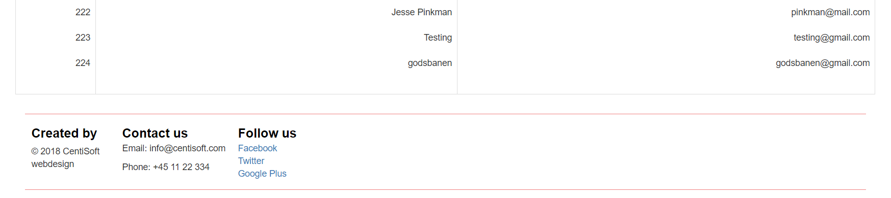
displayDevelopers.html

Slide 6
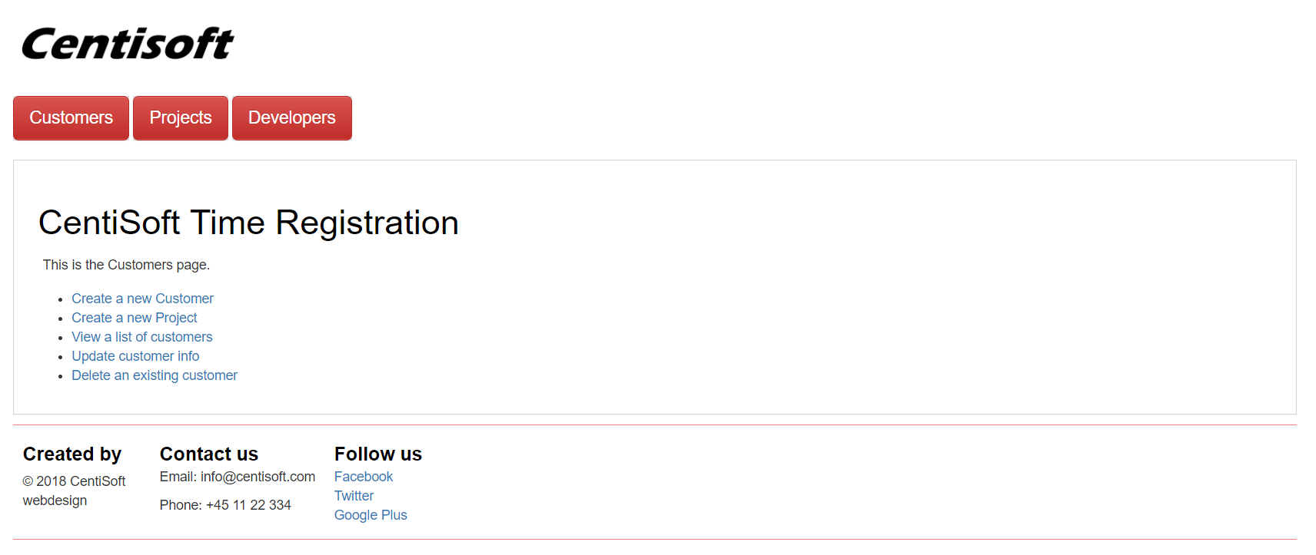
customers.html

Slide 7
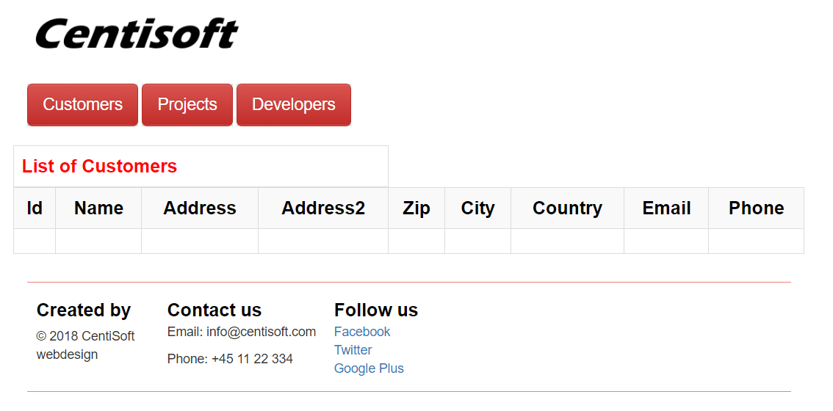
displayCustomers.html

Slide 8
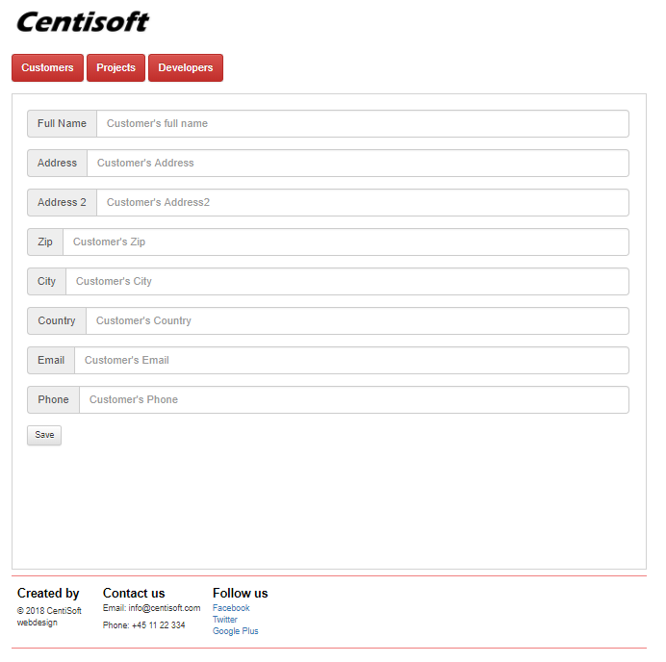
createCustomers.html

Slide 9
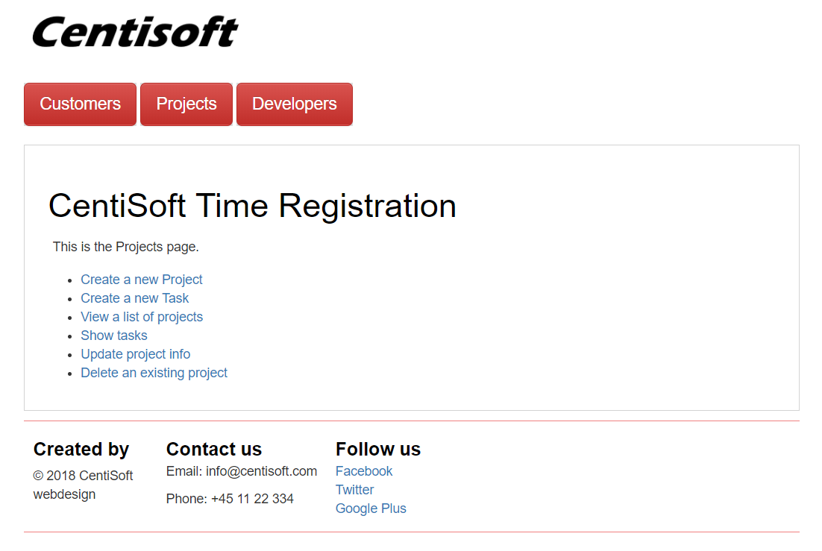
projects.html

Slide 10
Struggles
Implementing Bootstrap
Failed to load data from http://www.centisoft.dk/api/Customer
Figuring out JavaScript

Slide 11
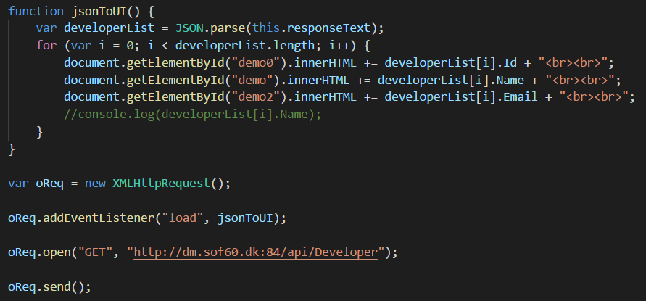
Implementation – JS Callbacks

Slide 12
Reflection - choices of technology

